Slide 1

Australian Economy Analysis
Monash FinTech Bootcamp 07/2021
Michelle
michelleqiaox@gmail.com
Scott
core3dsport@gmail.com
Jenny
jenny.tnguyen76@gmail.com
Thapa
tthapa3@gmail.com

Slide 2


How did we do during the Pandemic…

Slide 3




Summary
Michelle (Strategy Consultant)
Data manager and analytical strategist
Scott (Quality Assurance Manager)
Data cleanup and explorations: Foundation of any project
Jenny (Project Engineer)
Graphs and findings: Australia has done well
Thapa (Project Manager)
Dashboard and App: Powerful Interactive resource available to anyone

Slide 4

Data Cleanup & Exploration
1. Data Cost
Real estate Market - Corelogic
2. Data Reliability
Domain.com data based on listings, false indication
ASX200-Yahoo finance API
3. Resources
ASX200-Yahoo finance API
SP-500- API
World Bank- API
Australian Bureau of Statistics

Slide 5
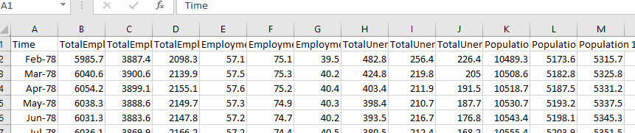
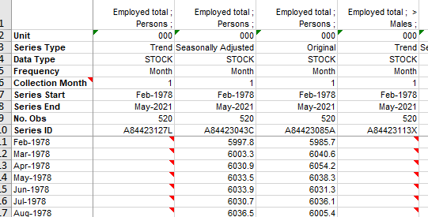
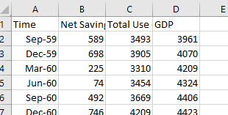
Data Cleanup & Exploration
4. Data Interpretation
Employment- Unit Metrics
Populations-Value Vs. Percentage - Millions Vs. Thousands
Naming Values - Stocks
Converting XLS to CSV
Converting Dates
Converting from Monthly to Yearly
Yearly to 5 years
Renaming Indexes
Global GDP

Slide 6

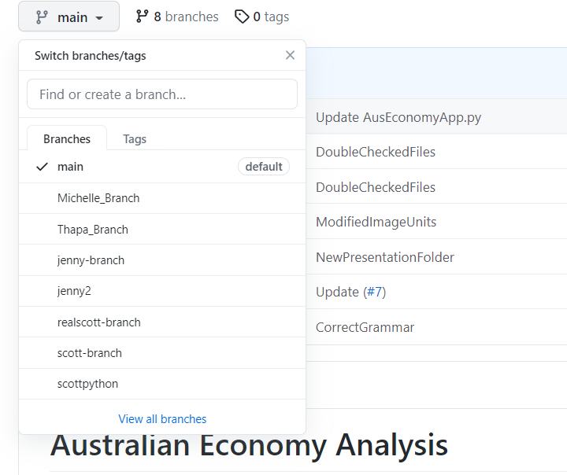
Data Cleanup & Exploration
5. Data Management
Naming System (Original-Raw-Processed)
Backup Data - back up every process
Create separate folders
Never delete files
GitHub-Merge
Working out of branches
Communication
Build master

Slide 7
Data Analysis
Australia’s Demographic
Australia’s Financials
Australia’s GDP
Australia vs Other countries

Slide 8
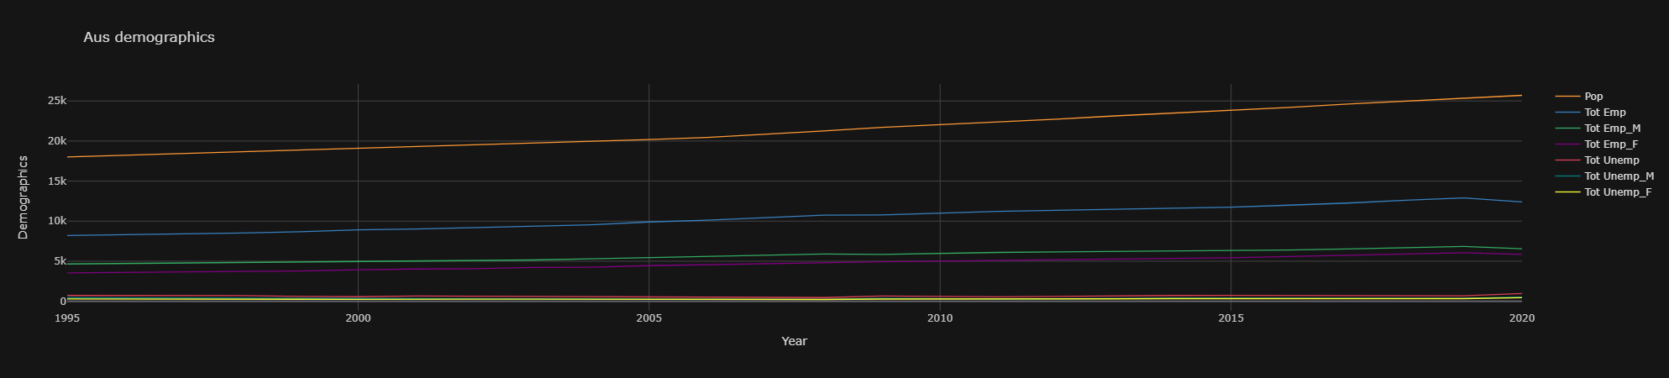

Australia Demographic Data

Slide 9
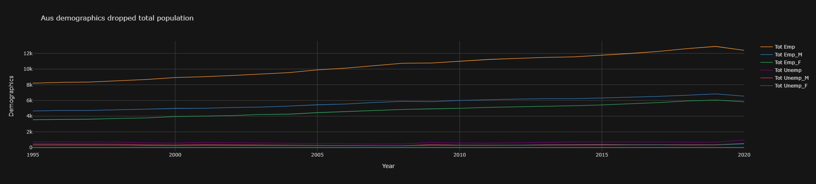
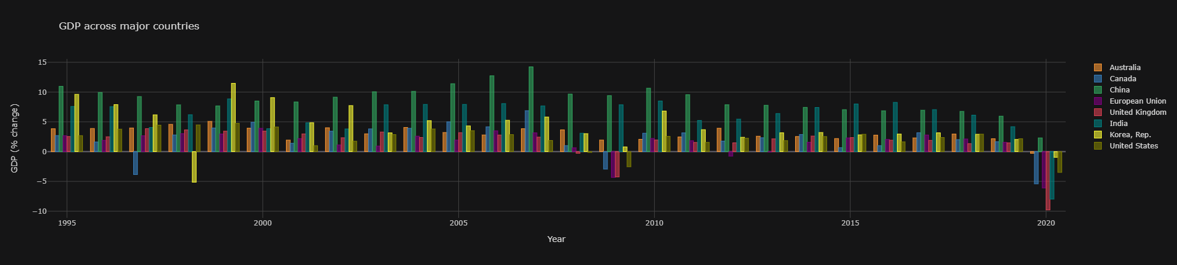
Australia Demographic Data

Slide 10
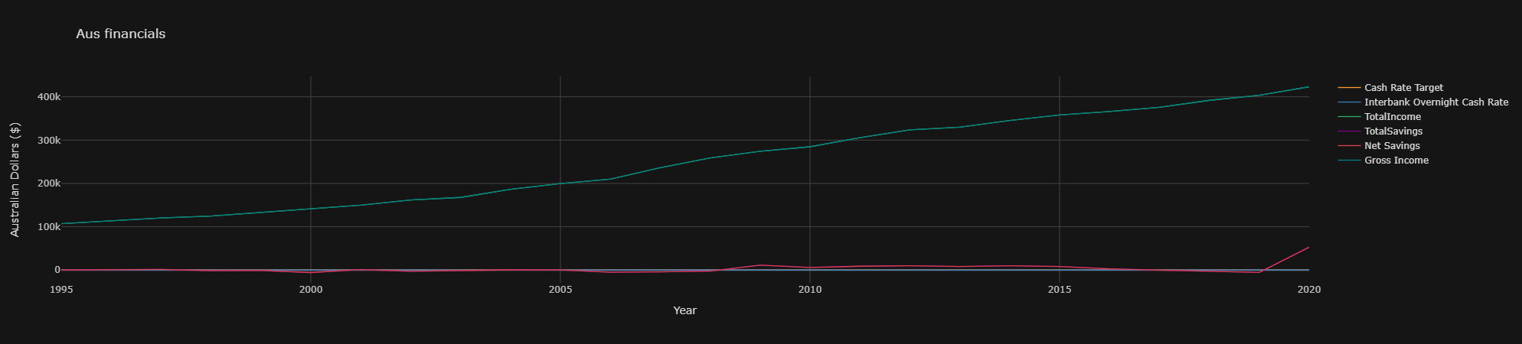
Australia’s Financials

Slide 11
Australia's GDP VS The World

Slide 12
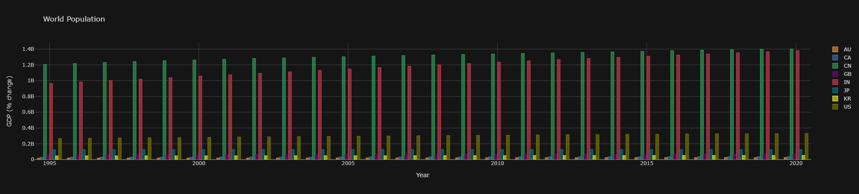
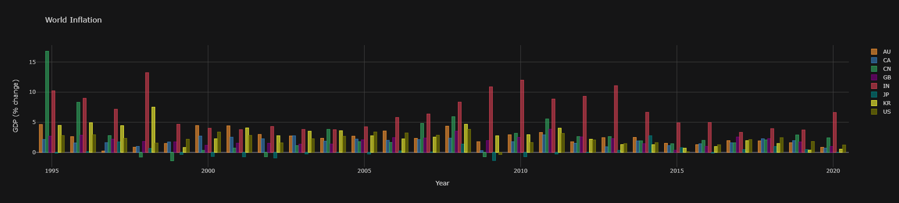
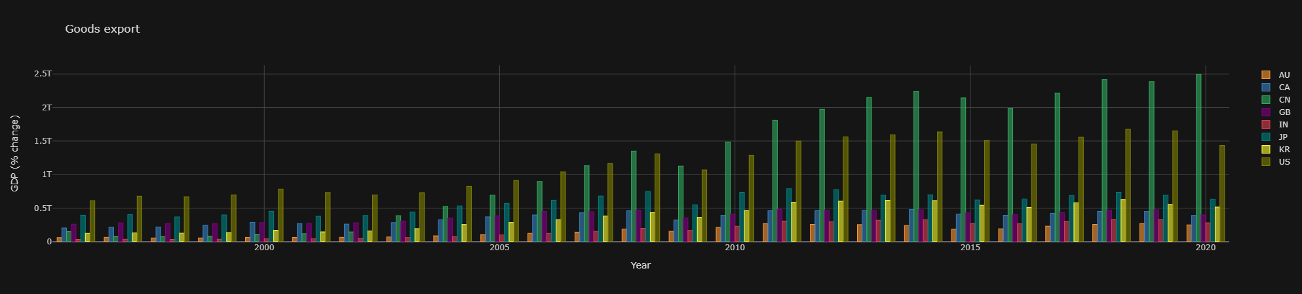
World Population

Slide 13
World Inflation

Slide 14
Goods Export

Slide 15
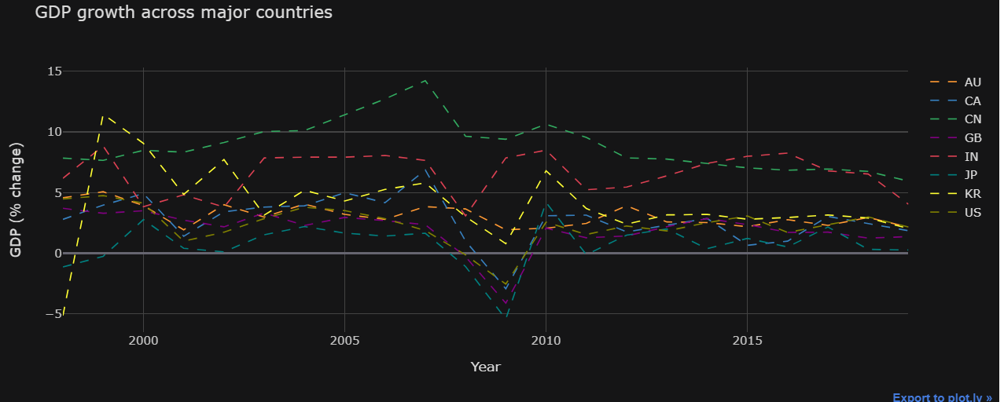
Australia's GDP VS The World

Slide 16
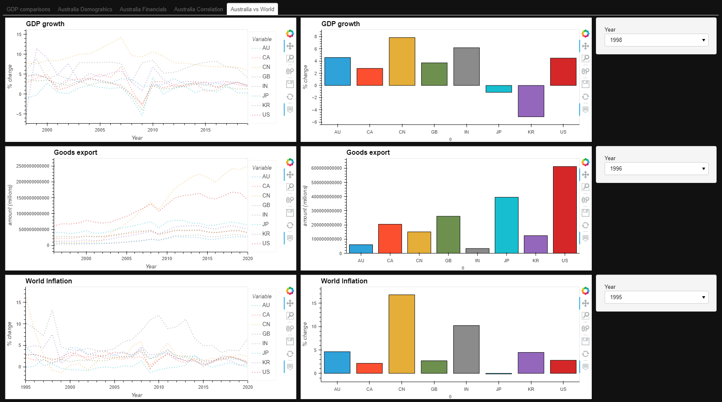
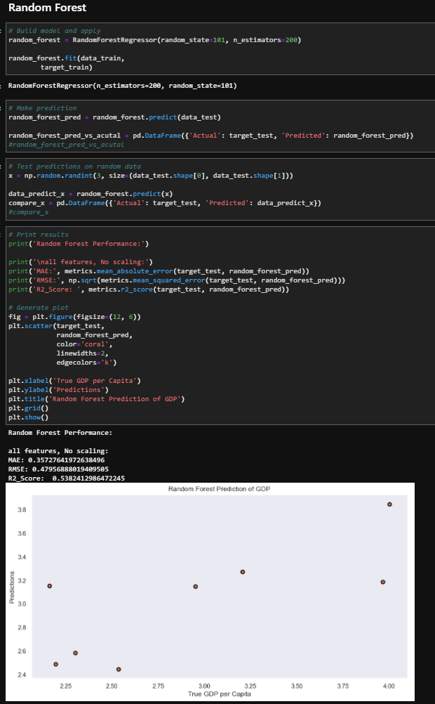
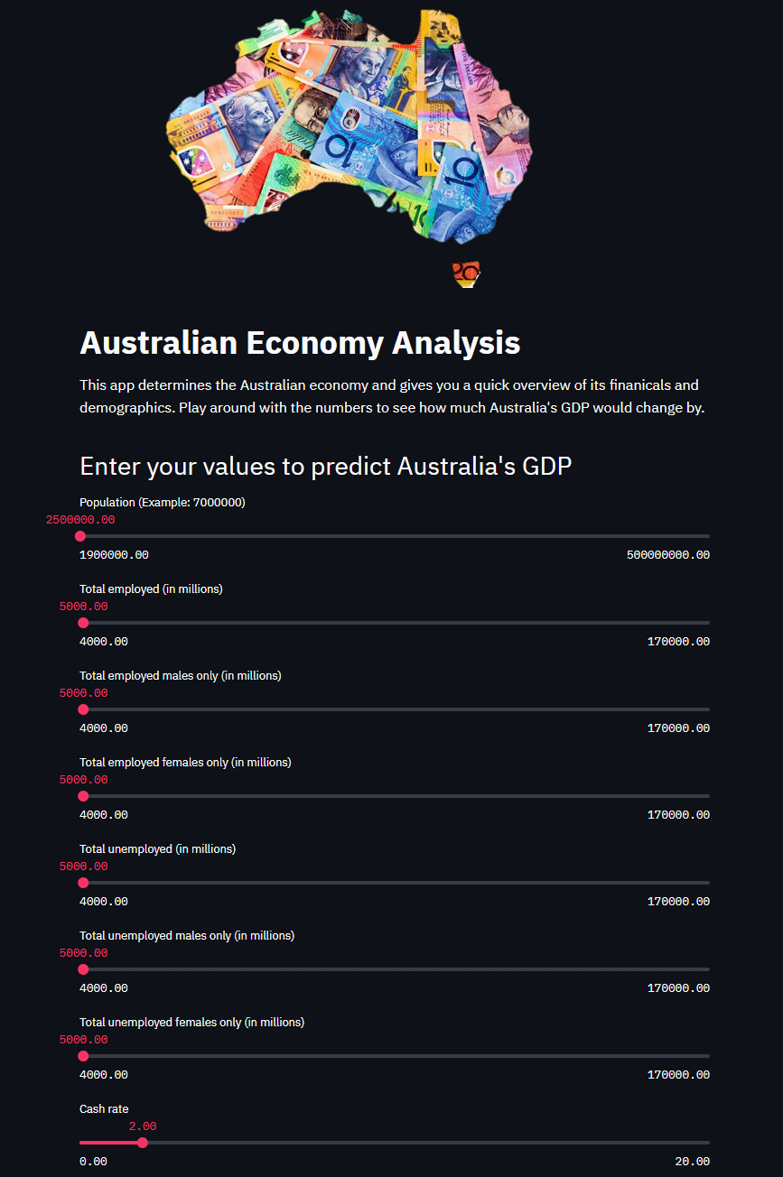
Dashboard & App

Slide 17
Difficulties arose…
GitHub collaboration
Conflicting issues

Slide 18
If we have 2 more weeks…
Get more data to determine GDP
Develop tools to forecast GDP

Slide 19




Any Questions…

Slide 20
References
Australia Bureau of Statistics
WorldBank
CuffLinks
Plotly
Machine Learning Classifiers
StreamLit
CoreLogic

